Slide 1
Opening a vegetarian restaurant in Brooklyn, NY
Anton Palladin

Slide 2
The Data Sources
In the framework of this project, I’ll be using several data sources, including:
New York neighborhood data as per NY neighborhood data
NYC real estate sales data (https://geo.nyu.edu/catalog/nyu-2451-34678)
Foursquare api service (https://api.foursquare.com/)
NY subway stations data (https://geo.nyu.edu/catalog/nyu-2451-34503)
NY universities locations (https://geo.nyu.edu/catalog/nyu-2451-34491)

Slide 3
Methodology and purpose
Purpose: Open a vegetarian restaurant in Brooklyn, NY, ideally near the NYC College of Technology.
Methodology:
Exploratory analysis
Cluster segmentation analysis
Visual data geo-analysis

Slide 4
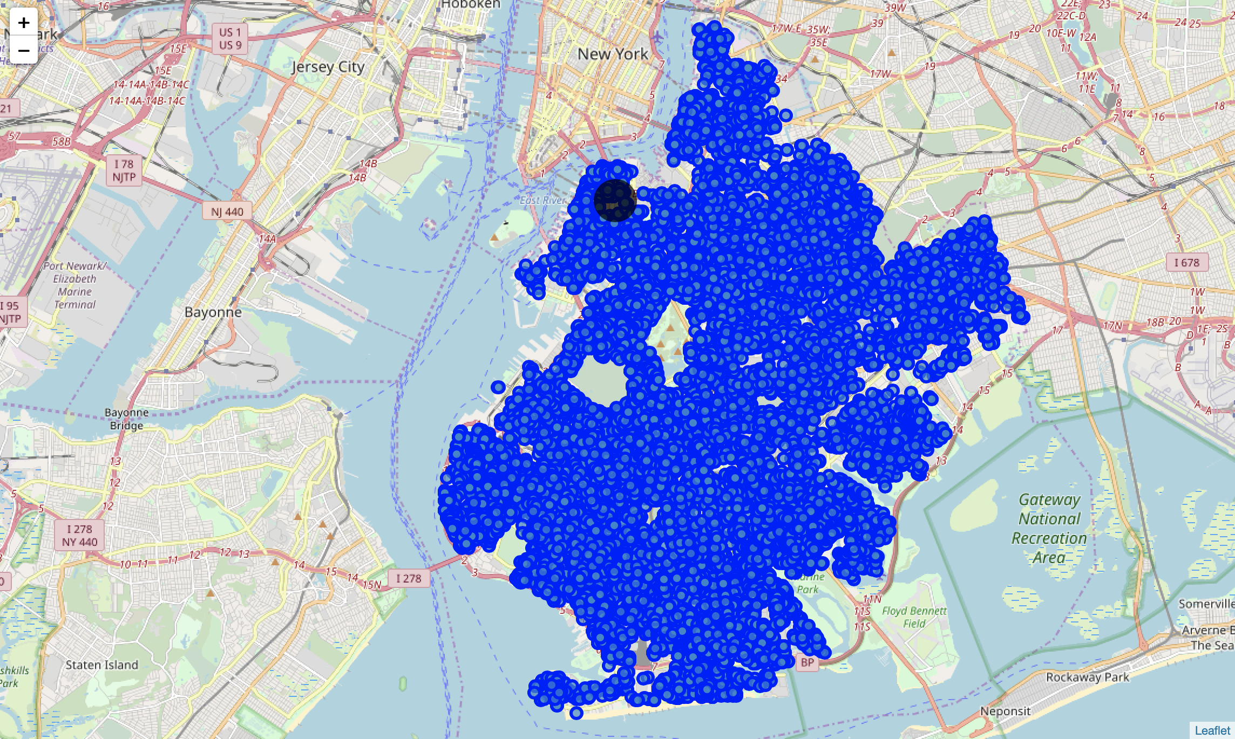
Brooklyn map of real estates sales for 2015
About 14800 sales deals were made in Brooklyn in the year of 2014.
The price varied between 350,000 USD and 900,000 USD per deal
The most popular sales type have been Elevator apartments, one to three Family Dwellings

Slide 5
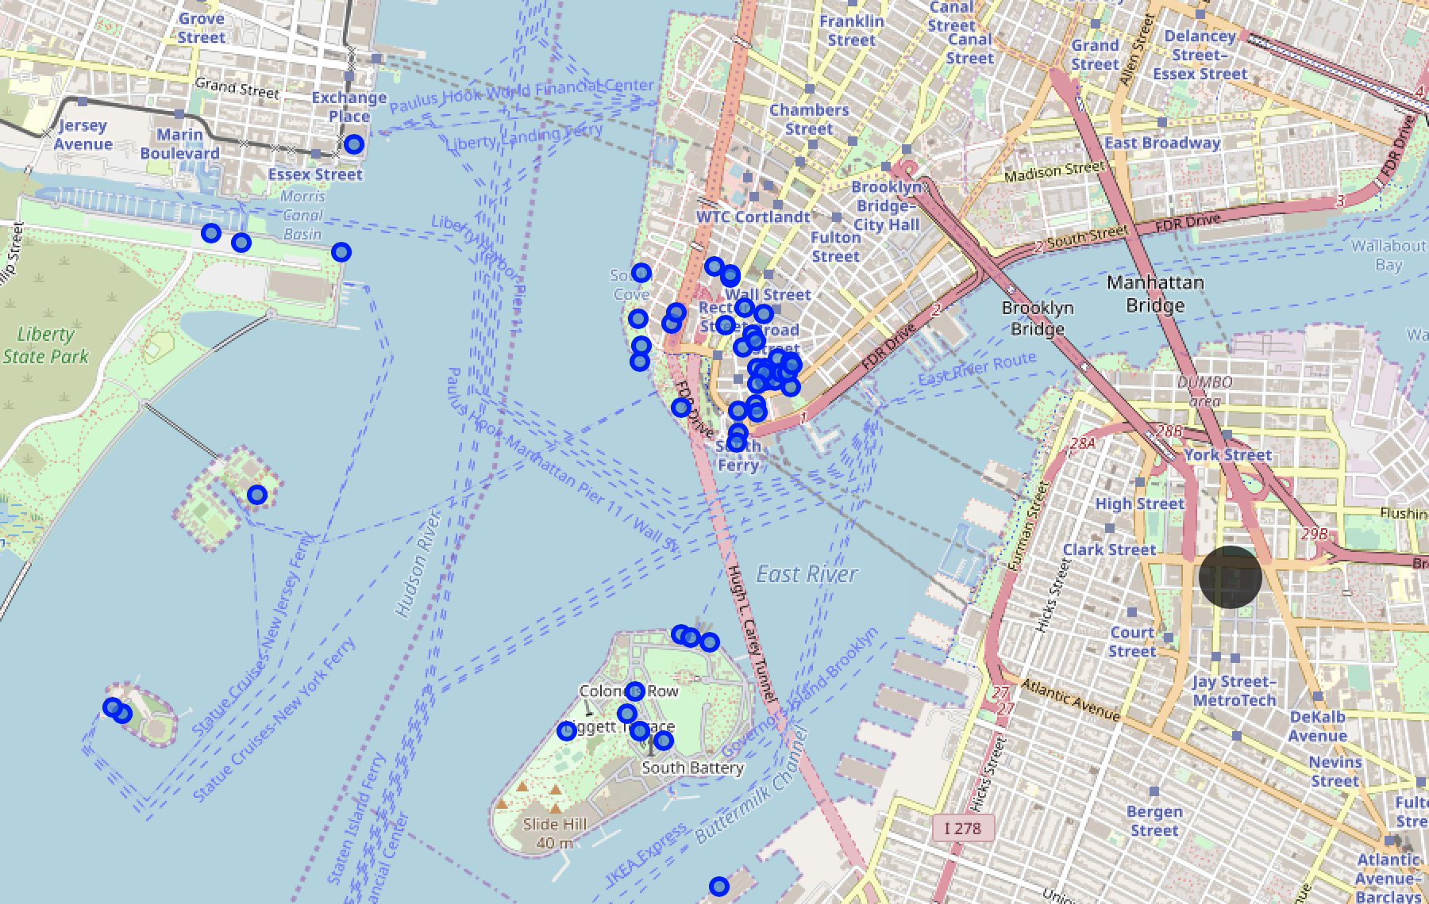
Nearby places categories around NYC College of Technology
OVER 50 VENUES IN RANGE OF 2 KM
Mexican Restaurant - 6
Food Truck - 5
Italian Restaurant & Pizza Place - 5
Café - 5
American Restaurant - 5
Sandwich Place - 4

Slide 6
Main competitors based on clustering
 | Venue | Venue Category | Price tier | Likes count | Rating
0 | Gigino at Wagner Park | Italian Restaurant | High end | 109 | 8.2
1 | Naya Express | Lebanese Restaurant | Mid-range | 92 | 9.1
2 | Adrienne's Pizza Bar | Pizza Place | High end | 128 | 8.3
3 | Bluestone Lane | Café | Mid-range | 82 | 8.0
4 | Maritime Parc | American Restaurant | Mid-range | 143 | 8.2
5 | Inatteso Pizzabar Casano | Pizza Place | Mid-range | 183 | 8.2
6 | Inatteso Cafe Casano | Café | Mid-range | 117 | 8.2
7 | Cipriani | Italian Restaurant | Mid-range | 81 | 8.0
8 | Le Pain Quotidien | Bakery | Mid-range | 227 | 7.8
9 | Pret A Manger | Sandwich Place | Mid-range | 96 | 7.6
10 | Mad Dog & Beans Mexican Cantina | Mexican Restaurant | Mid-range | 115 | 7.6
11 | Sauce & Barrel | Pizza Place | High end | 29 | 6.2

Slide 7
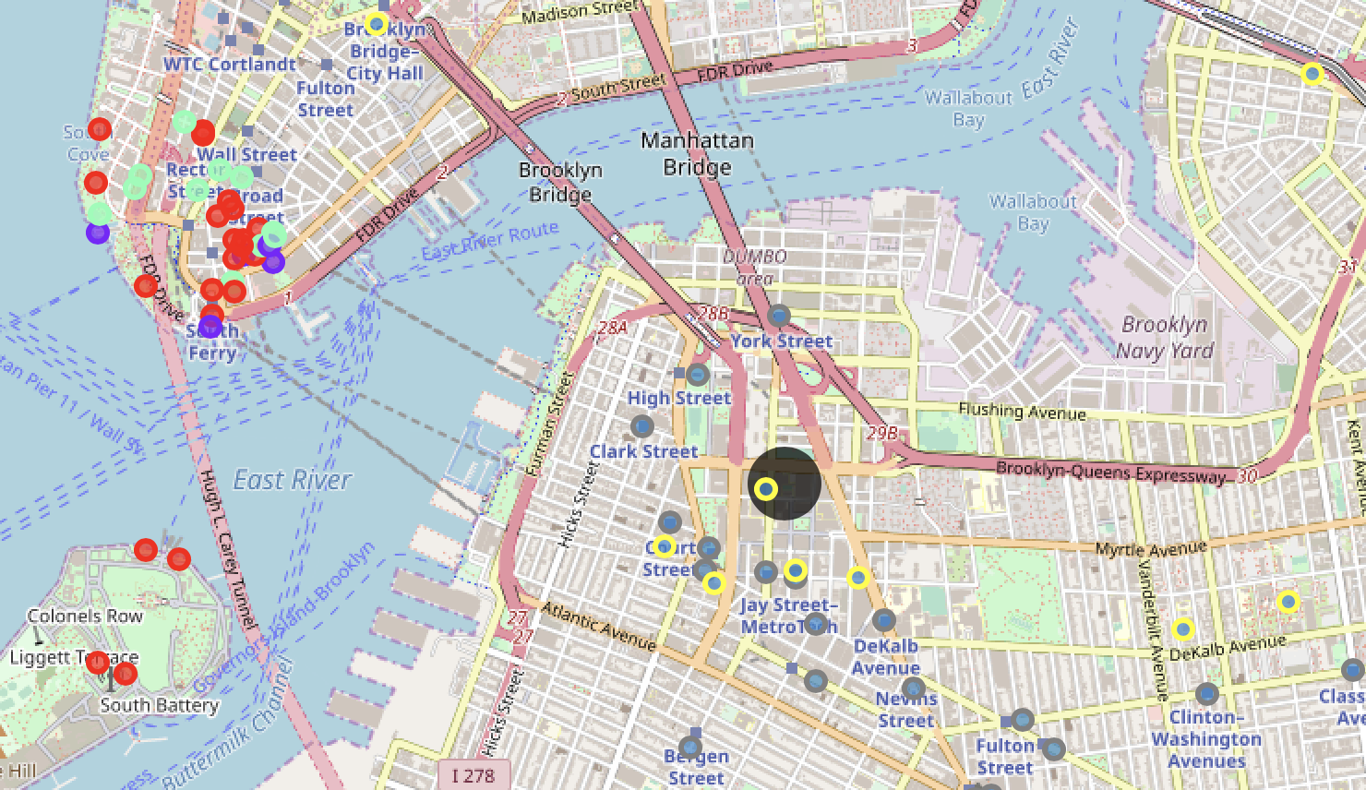
Location segmentation with subway and schools
No competitor restaurants in vicinity of at least 1km - all of them on the other side of East river (marked with different colors)
Availability of the three subway stations nearby (marked in grey)
Presence of five educational institutions with the target audience (marked in yellow)

Slide 8
Street recommendation for the new venue
Jay Street,
Adams Street,
Fulton Mall,
Boothby street,
Tillary Street.

